Slide 1
Pic 10C Project Bruinopoly
Team members: Yuxin Qian, Daniel Becerra, Chuqi Bian, Hao Zheng

Slide 2
Bruinopoly
> It’s our UCLA version of the Monopoly Game
>The basic process is like a normal monopoly, but we added many special features to make it unique and complex.
>The game program is made up by a welcome window, a game setup page and a main window for gameboard.

Slide 3
Class Hierarchy
>UI class:
GameBoard, PlayerInfoDisplay, QLandingWindow, Movement
>Other class:
Mainwindow, Bank, Board, Dice,

Slide 4
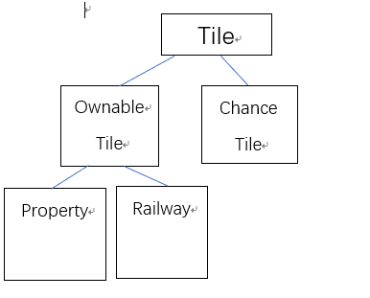
Tile Class Hierarchy

Slide 5
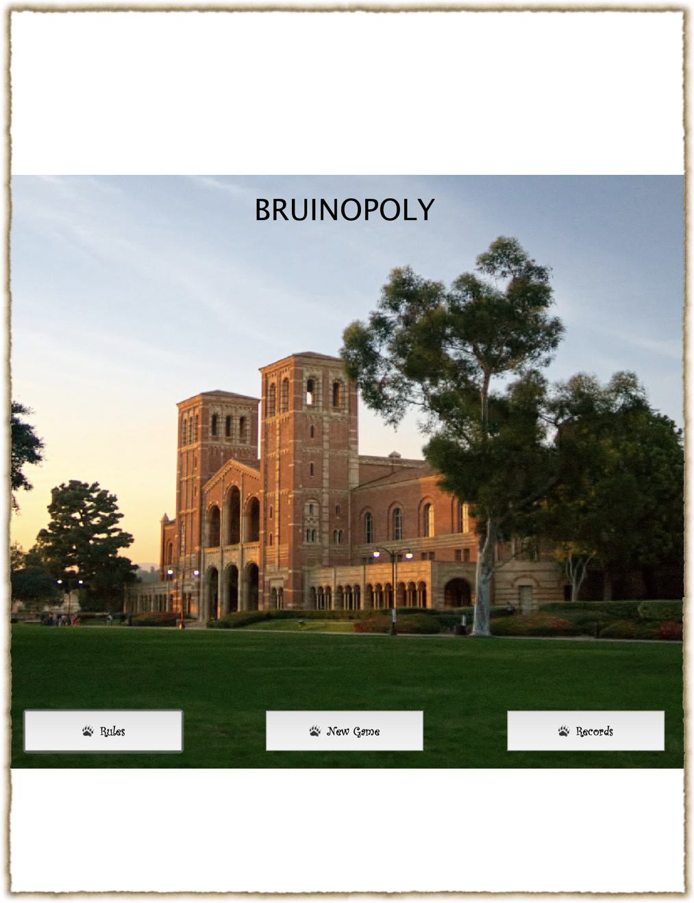
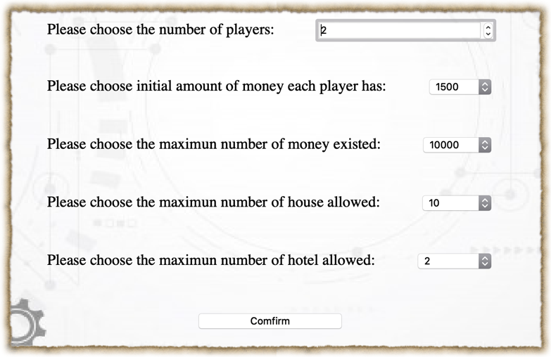
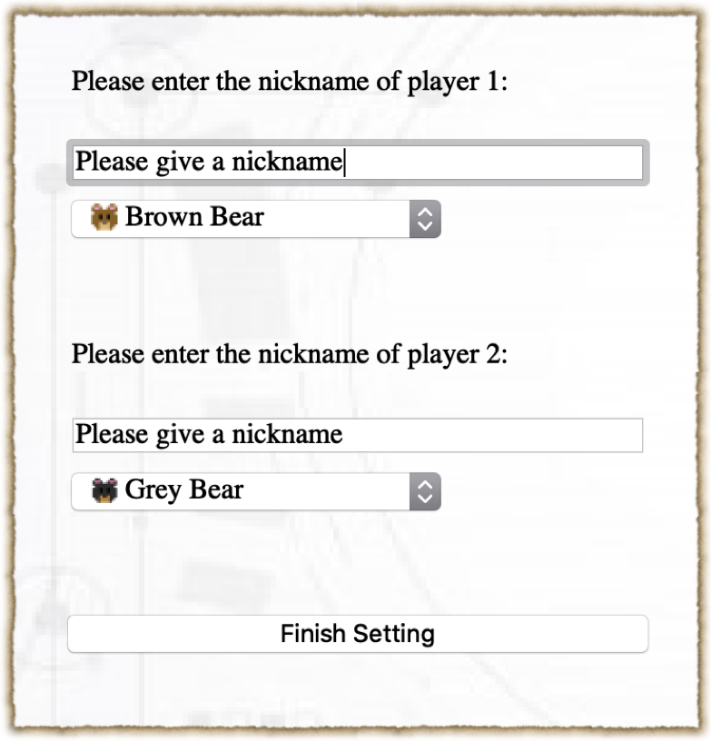
You can choose up to 4 players.
Also, you can decide the initial money and game setup!
Besides NewGame, there is also a Record page that can show the past game record.
Players can choose from different bear characters

Slide 6
Since some random events may not be shown in the presentation, we would firstly use some screenshots to exhibit those special events.

Slide 7
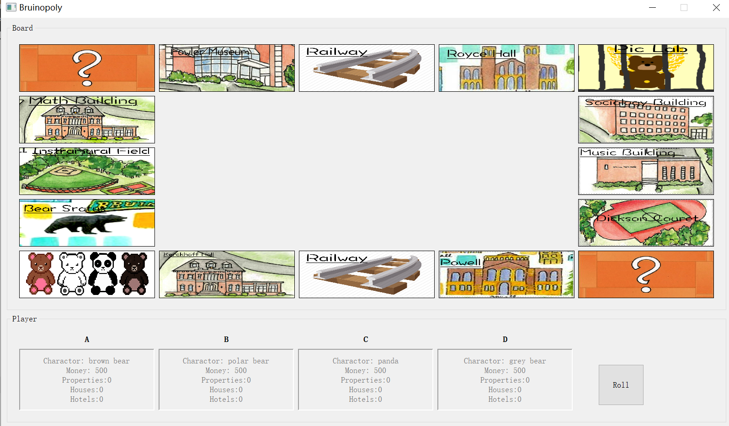

The gameboard contains 13 buyable properties. Different properties have different prices and rents. When landing on the property, certain property with information would show up

Slide 8
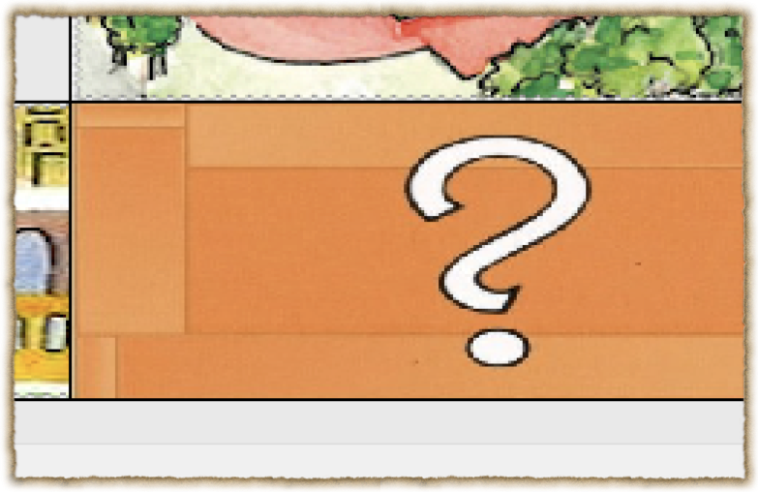

when Landing on the Chance
cards, a card generated by
QRand would show up.
Likely events includes gaining
money, losing money,
stopping for one turn or
going to the pic lab (jail.)

Slide 9
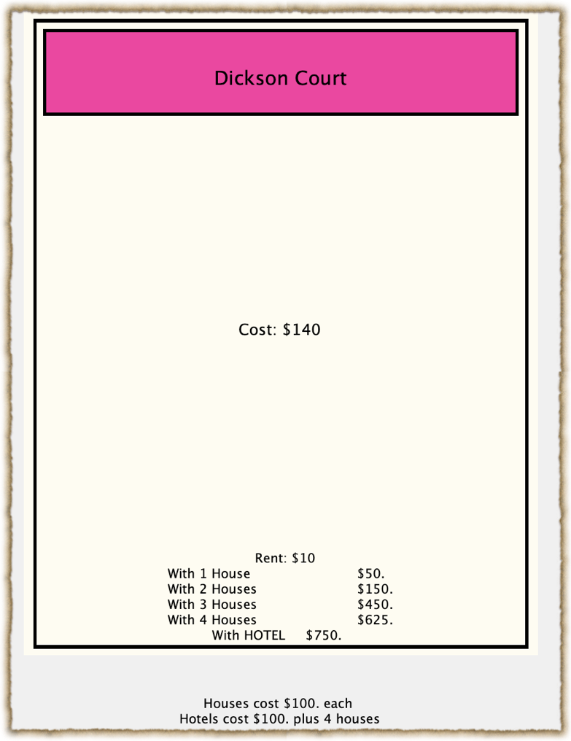
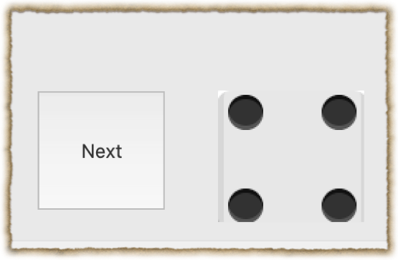
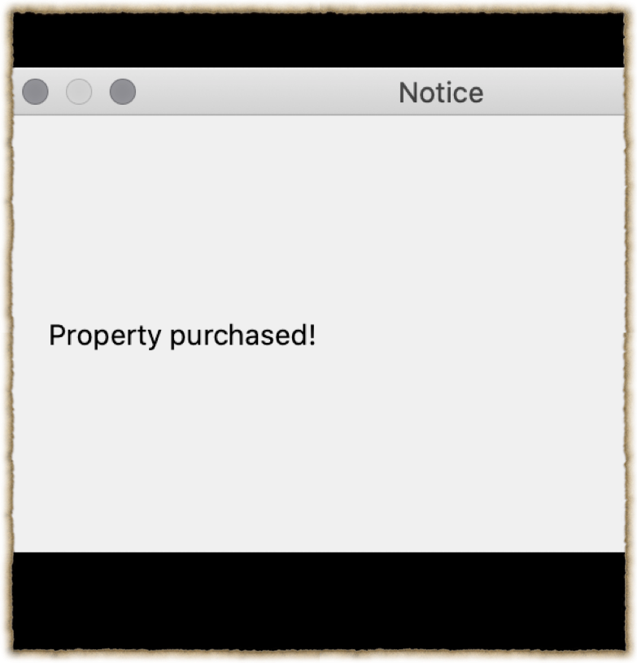
The dice would generate
random steps.
When landing on a property, the program will check whether it is
owned. You can buy owned property. Otherwise, you will need
to pay a rent

Slide 10
>Players can add houses and hotels to their properties.
In this case, other players landing on it would be forced to pay a higher rent.
> When all the other players bankrupt, the
remaining one would be the winner.
>The game record would show up on the record
page.

